Slide 1

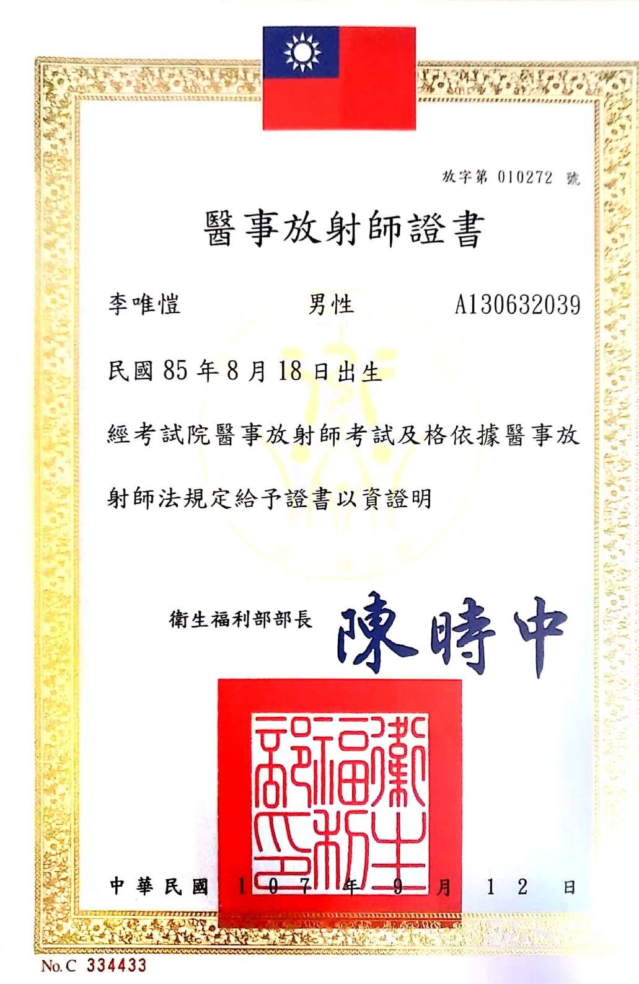
李唯愷 Wei-Kai Lee Ph.D.
Postdoctoral Research Fellow
Institute of Biophotonics,
National Yang Ming Chiao Tung University, 155 Li-Nong St.,Sec.2,Taipei,Taiwan 112
Tel: 0978073290
Email: l850818@gmail.com
Education
Bachelor Degree (09/2014-06/2018)
Department of Biomedical Imaging and Radiological Sciences, National Yang-Ming University, Taipei, Taiwan
Ph.D. Degree (08/2019-08/2022)
Department of Biomedical Imaging and Radiological Sciences, National Yang Ming Chiao Tung University, Taipei, Taiwan
Experience
Postdoctoral Research Fellow (09/2022-)
Institute of Biophotonics, National Yang Ming Chiao Tung University, Taipei, Taiwan
Clinical Attachment (07/2017-01/2018)
Department of Radiology, Nuclear medicine, Radiation Oncology, Taipei veterans General Hospital
Publication:
Lee, W. K., Yang, H. C., Lee, C. C., Lu, C. F., Wu, C. C., Chung, W. Y., ... & Wu, Y. T. (2023). Lesion delineation framework for vestibular schwannoma, meningioma and brain metastasis for gamma knife radiosurgery using stereotactic magnetic resonance images. Computer Methods and Programs in Biomedicine, 229, 107311.
Lee, CC.*, Lee, WK.*, Wu, CC. et al. Applying artificial intelligence to longitudinal imaging analysis of vestibular schwannoma following radiosurgery. Sci Rep 11, 3106 (2021). *: equal contribution
Hermann I, Martínez-Heras E, Rieger B, Schmidt R, Golla AK, Hong JS, Lee WK, Yu-Te W, Nagtegaal M, Solana E, Llufriu S, Gass A, Schad LR, Weingärtner S, Zöllner FG. Accelerated white matter lesion analysis based on simultaneous T1 and T2∗ quantification using magnetic resonance fingerprinting and deep learning. Magn Reson Med. 2021 Feb 5. doi: 10.1002/mrm.28688. Epub ahead of print. PMID: 33547656.
Huai-Che Yang, Chih-Chun Wu, Cheng-Chia Lee, Huai-En Huang, Wei-Kai Lee, Wen-Yuh Chung, Hsiu-Mei Wu, Wan-Yuo Guo, Yu-Te Wu, Chia-Feng Lu, Prediction of pseudoprogression and long-term outcome of vestibular schwannoma after Gamma Knife radiosurgery based on preradiosurgical MR radiomics, Radiotherapy and Oncology, Volume 155, 2021, Pages 123-130, ISSN 0167-8140.
Wei-Kai Lee*, Chih-Chun Wu*, Cheng-Chia Lee, Chia-Feng Lu, Huai-Che Yang, Tzu-Hsuan Huang, Chun-Yi Lin, Wen-Yuh Chung, Po-Shan Wang, Hsiu-Mei Wu, Wan-Yuo Guo, Yu-Te Wu. Combining analysis of multi-parametric MR images into a convolutional neural network: precise target delineation for vestibular schwannoma treatment planning. Artificial Intelligence in Medicine, 107:101911, 2020. *: equal contribution

Slide 2
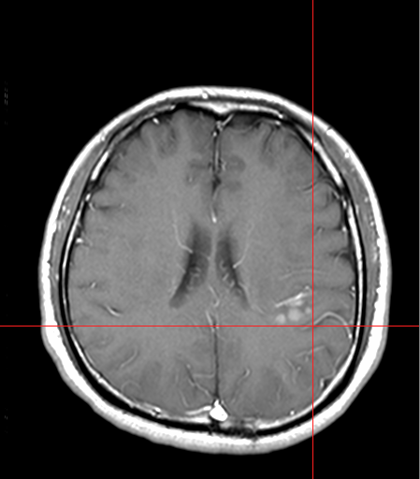
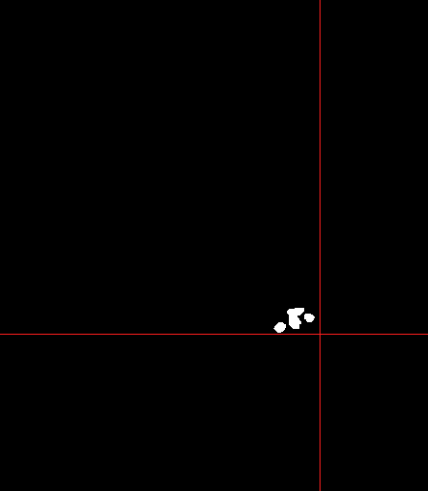
Purpose: DICOM RT Contours Export
Acquire the MR image data and annotation of the targets at the MR images from DICOM file → Annotation also call contour, pixel label, or ROI (Region of Interest)
MR image
Pixel label

Slide 3
Outline
Digital Imaging and Communications in Medicine, DICOM
How to decode the DICOM files
How to extract the annotations from DICOM files

Slide 4
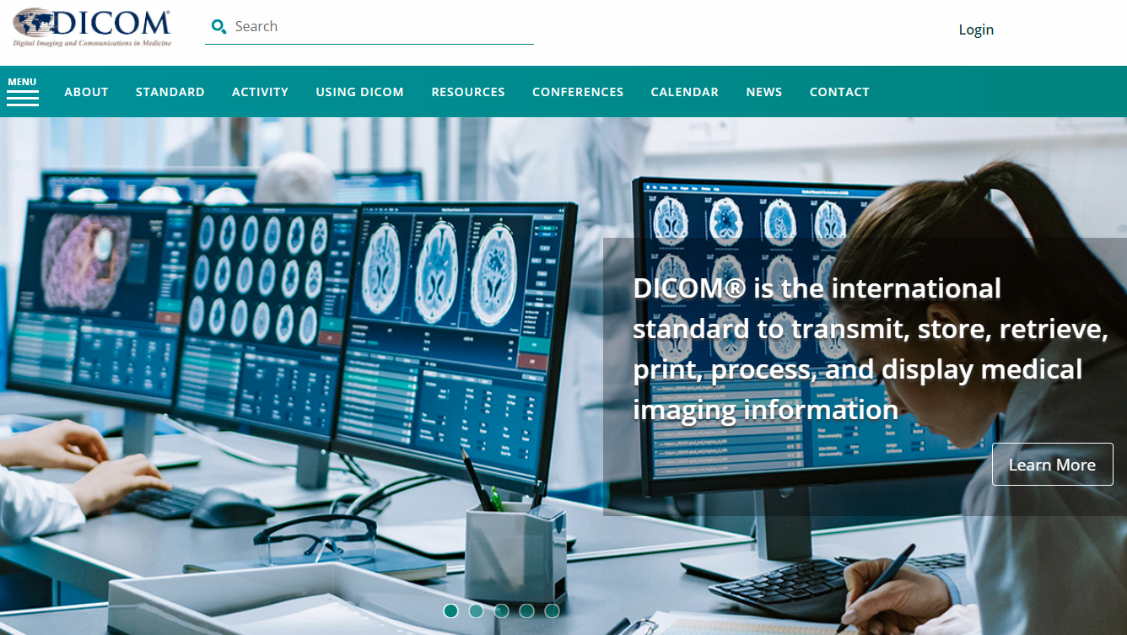
DICOM
Digital Imaging and Communications in Medicine, DICOM
All the equipment related to medical imaging must follow the DICOM format, include X-ray, CT, MR, RT…
Component:
Tags (header): ID, Age, Gender,…
2D array (pixel data)
Support:
X-ray
Computed Tomography, CT
Magnetic Resonance Imaging, MRI
Radiotherapy Structure Set, RTSS
Website: https://www.dicomstandard.org/

Slide 5
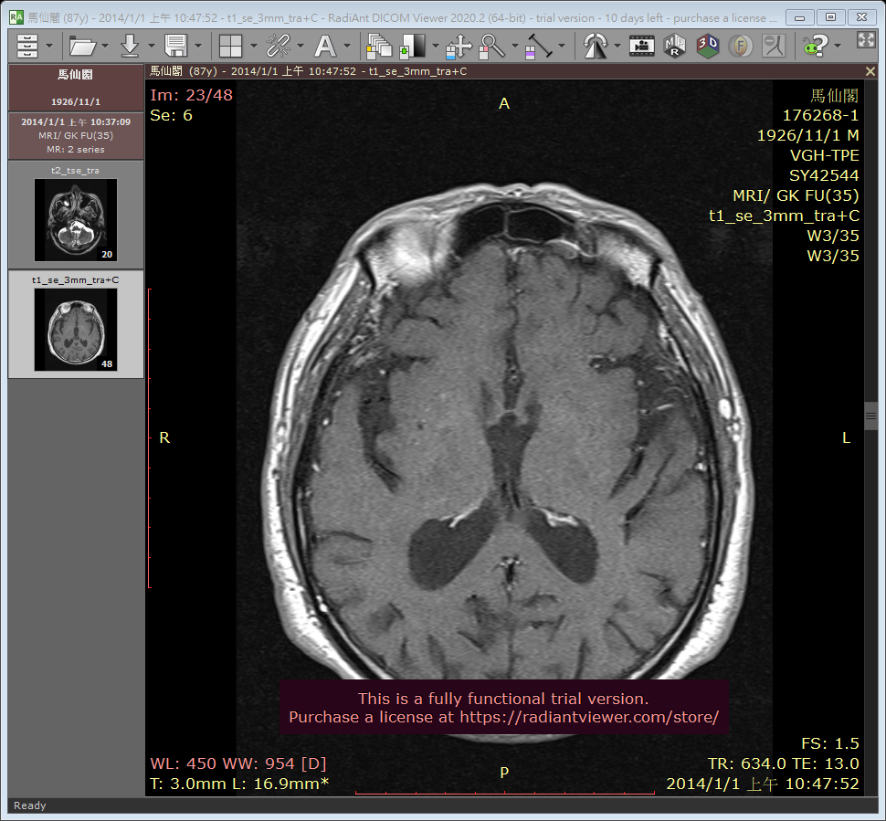

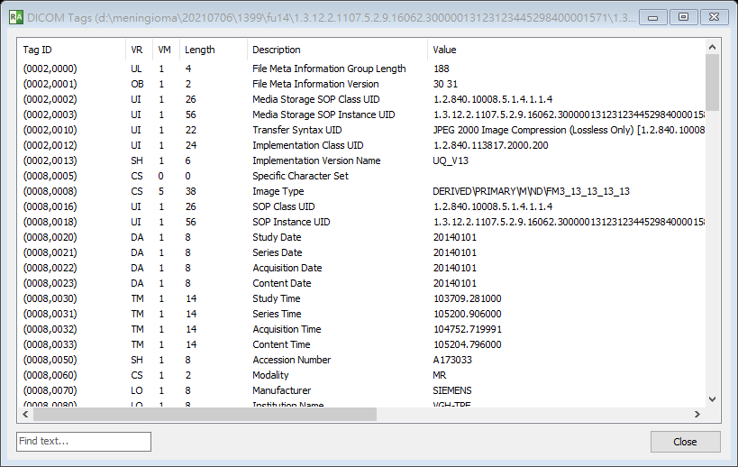
DICOM Viewer
RadiAnt DICOM VIEWER
https://www.radiantviewer.com/

Slide 6
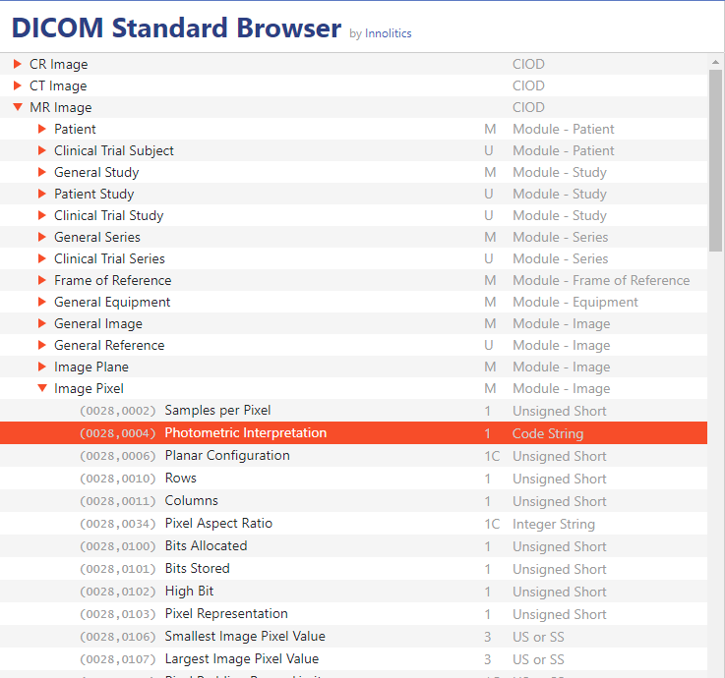
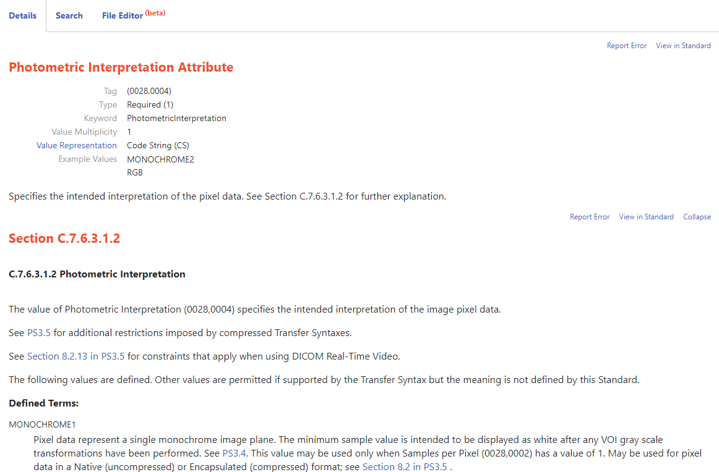
DICOM
DICOM Standard Browser: interpret the tag ID, header description, usage and the value
https://dicom.innolitics.com/ciods

Slide 7
Decode the DICOM files
Python: pydicom
dicom_ds=dcmread(dicom filename)→read dicom header and image
dicom_ds.PixelData, dicom_ds.pixel_array (recommand) →extract image array
MATLAB:
dicominfo: read header
dicomread: read image
C++:
ITK library

Slide 8
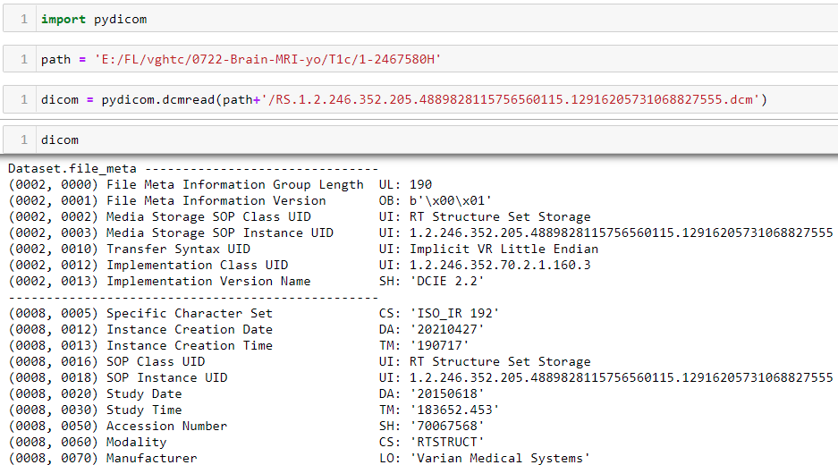
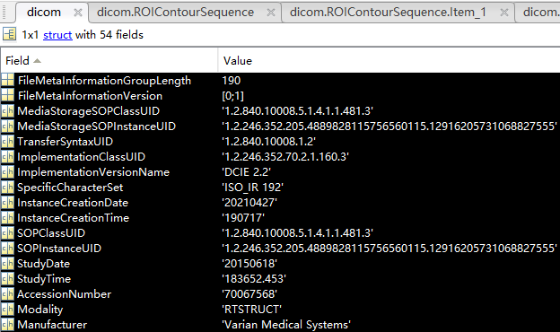
Decode the DICOM files
Python: dicom=pydicom.dcmread(filename)
MATLAB: dicom=dicominfo(filename)

Slide 9
Purpose: DICOM RT Contours Export
Acquire the MR image data and annotation of the targets at the MR images from DICOM file → Annotation also call contour, pixel label, or ROI (Region of Interest)
MR image
Pixel label

Slide 10
Roadmap
Read the DICOM RTSS file and confirm the modality
Identify the desired contour structures and acquire the contour data from DICOM RTSS
Identify which MR image the contour data allocate at
Convert the contour data from reference coordinate system to pixel location

Slide 11
Roadmap
Read the DICOM RTSS file and confirm the modality
Identify the desired contour structures and acquire the contour data from DICOM RTSS
Identify which MR image the contour data allocate at
Convert the contour data from reference coordinate system to pixel location

Slide 12
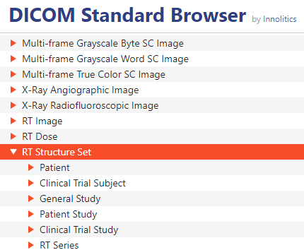
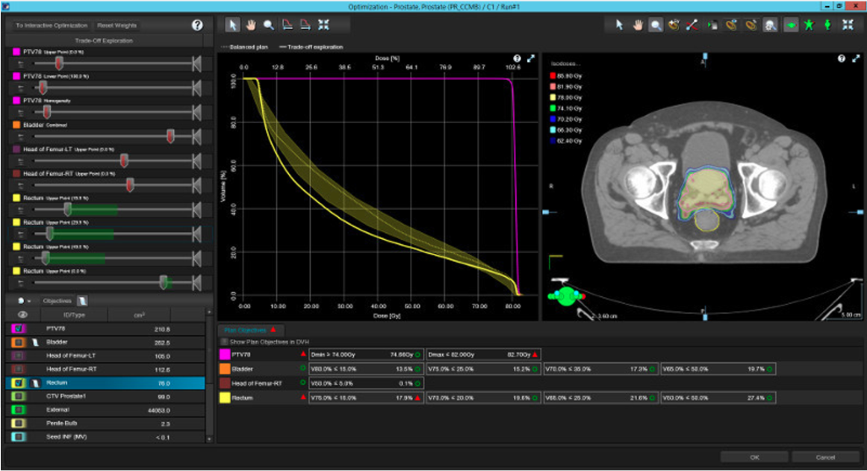
Radiotherapy Structure Set, RTSS
One of the DICOM formats
The software for radiotherapy must follow the DICOM RT format → treatment planning software, e.g. Eclipse, RapidPlan
Contents:
Patient Name
Age, Gender
Lesion contours for radiotherapy
Organ contours for dose-planning
No image data was saved in RTSS
https://www.varian.com/zh-hant/products/radiotherapy/treatment-planning/eclipse

Slide 13
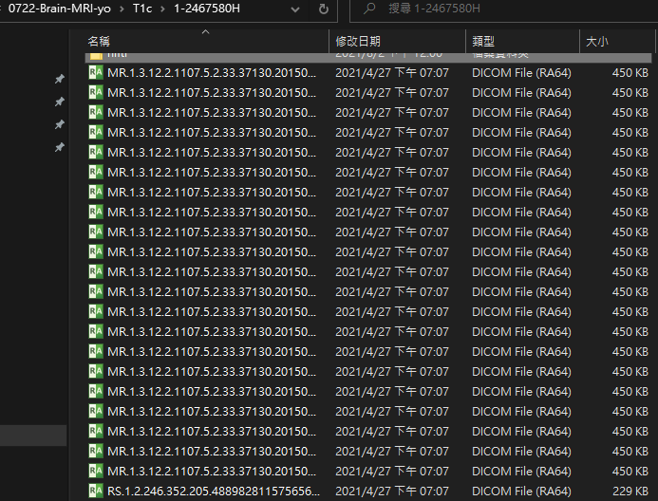
Read the DICOM RTSS and confirm the modality
Subject:
Patient with GBM in VGHTC
Imaging Modality:
MR imaging
Annotation Modality:
Varian system
DICOM files: MR images
(Slice/切面)
DICOM file: Radiotherapy Structure Set

Slide 14
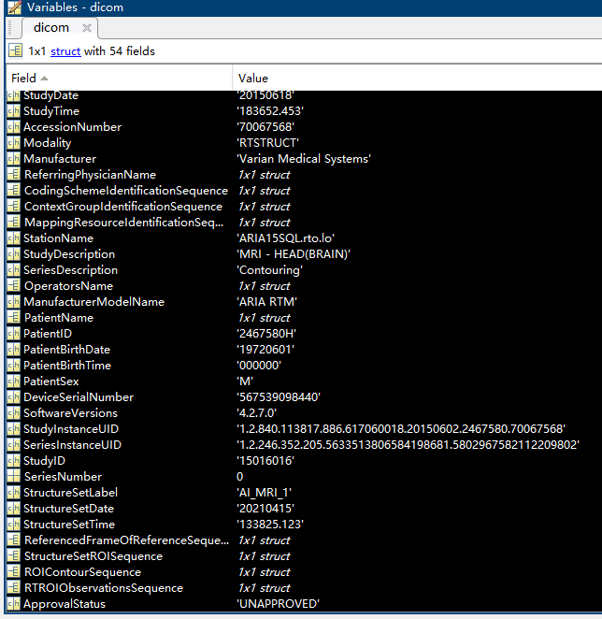
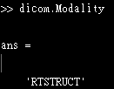
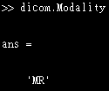
Read the DICOM RTSS and confirm the modality
Platform:
MATLAB
dicom=dicominfo(DICOM RTSS filename)
Confirm the modality
Radiotherapy structure set, RTSS
MR images

Slide 15
Roadmap
Read the DICOM RTSS file and confirm the modality
Identify the desired contour structures and acquire the contour data from DICOM RTSS
Identify which MR image the contour data allocate at
Convert the contour data from reference coordinate system to pixel location

Slide 16
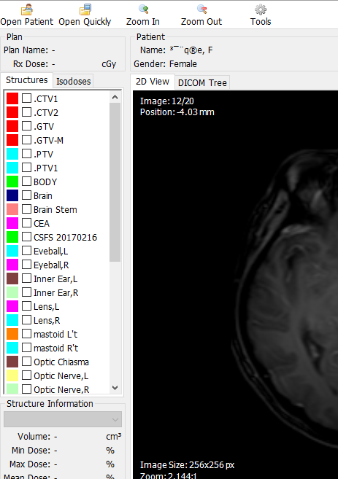
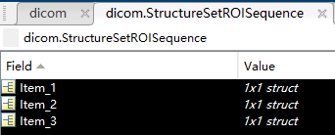
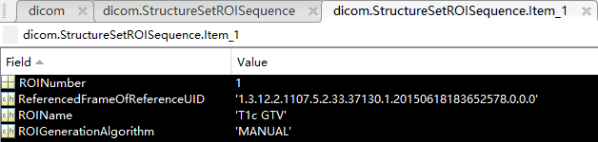
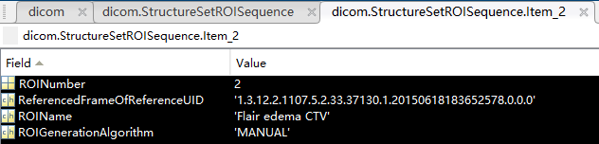
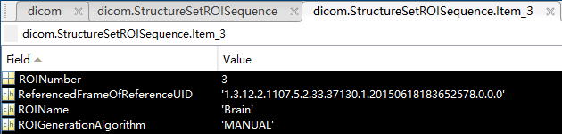
Identify the structure
Find the contour structures:
dicom.StructureSetROISequence
Obtain the ROI name to identify the correct ROI
Three contour structures were saved in this DICOM RTSS file.

Slide 17
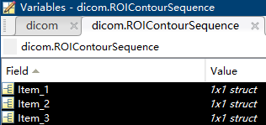
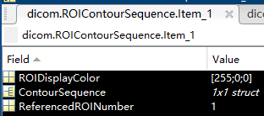
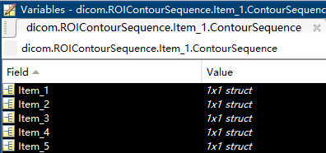
Acquire the contours of the desired structure
Find the contour sequence of structures:
dicom.ROIContourSequence
dicom.ROIContourSequence.Item_1.ContourSequence
Three contour data were saved in this DICOM RTSS file.
Close planar ROI
e.g. different close planar ROI items at different images or items at same image.
Multiple close planar ROI items

Slide 18
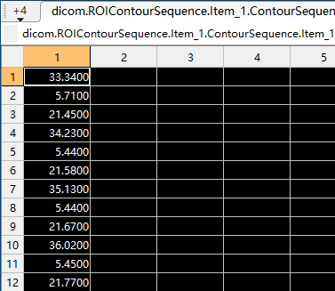
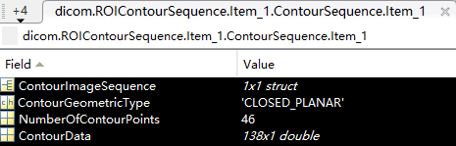
Acquire the contours of the desired structure
Find the contour data from sequence:
dicom.ROIContourSequence.Item_1.ContourSequence. Item_1.ContourData

Slide 19
Roadmap
Read the DICOM RTSS file and confirm the modality
Identify the desired contour structures and acquire the contour data from DICOM RTSS
Identify which MR image the contour data allocate at
Convert the contour data from reference coordinate system to pixel location

Slide 20
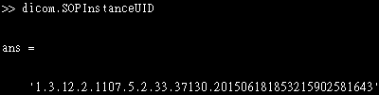
Identify the contour data allocate at
Read the DICOM MR image file
dicom=dicominfo(DICOM image filename)
DICOM MR image UID
dicom.SOPInstanceUID
DICOM files: MR images
DICOM file: Radiotherapy Structure Set

Slide 21
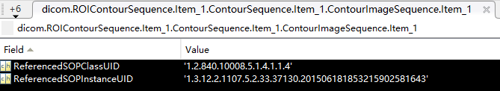
Identify the contour data allocate at
Find the image UID from sequence:
dicom.ROIContourSequence.Item_1.ContourSequence. Item_1.ContourImageSequence.Item_1.ReferenceSOPInstanceUID

Slide 22
Acquire the contour data and located image
Contour data
Located image UID
X coordinate
Y coordinate
Z coordinate
unit: millimeter
The coordinate is not the pixel location!

Slide 23
Roadmap
Read the DICOM RTSS file and confirm the modality
Identify the desired contour structures and acquire the contour data from DICOM RTSS
Identify which MR image the contour data allocate at
Convert the contour data from reference coordinate system to pixel location

Slide 24
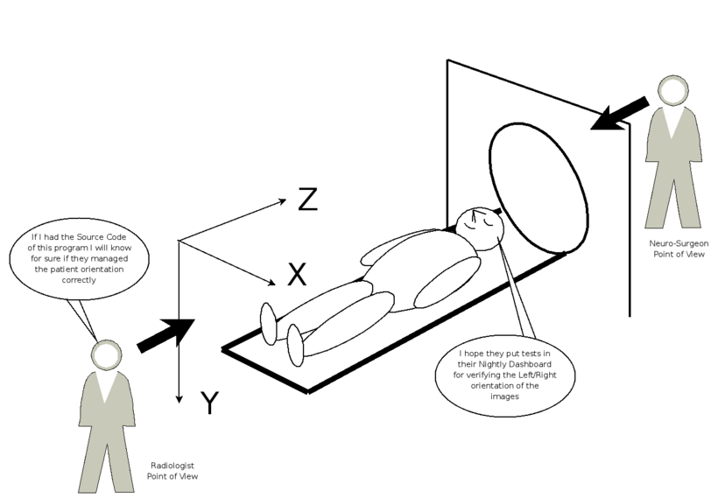
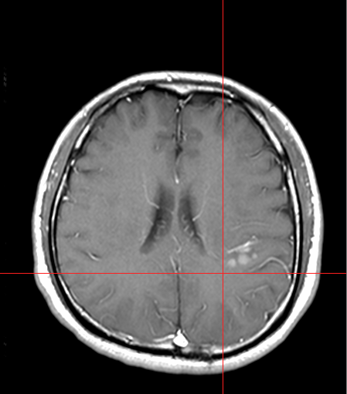
Reference coordinate system, RCS
RCS in patient direction:
X-axis: right → left
Y-axis: anterior → posterior
Z-axis: inferior → superior
Also known as LPS orientation
X
Pixel array
0 | 0 | 1 | 0
0 | 1 | 0 | 1
0 | 0 | 1 | 0
0 | 0 | 0 | 0
Y
unit: millimeter
https://itk.org/Wiki/Proposals:Orientation

Slide 25
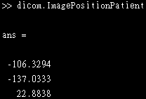
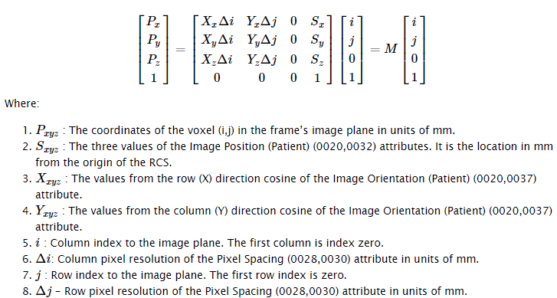
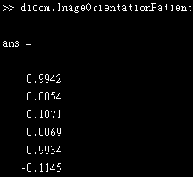
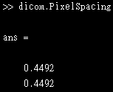
Reference coordinate system, RCS
Transform from pixel location to RCS
RCS coordinate=M*Pixel location
Obtain from the header of the located image
https://nipy.org/nibabel/dicom/dicom_orientation.html

Slide 26
Convert the RCS coordinate to pixel location
Pixel array
RCS coordinate=M*Pixel location → M⁻¹*RCS coordinate=Pixel location
0 | 0 | 1 | 0
0 | 1 | 0 | 1
0 | 0 | 1 | 0
0 | 0 | 0 | 0
unit: millimeter
Pixel location
Polygon to mask
M⁻¹
X coordinate
Y coordinate
Z coordinate
Column index
Row index
Slice index (optional)
Pixel label
0 | 0 | 1 | 0
0 | 1 | 1 | 1
0 | 0 | 1 | 0
0 | 0 | 0 | 0
The coordinate is RCS coordinate

Slide 27
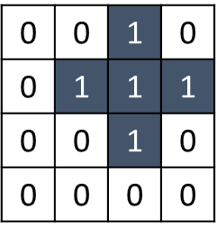
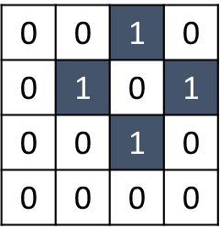
Flowchart of contour export from RTSS
Identify the desired structure
Acquire the contours of the desired structure
1
Confirm the modality of DICOM file is RTSS
2
3
ROIContourSequence
StructureSetROISequence
Radiotherapy structure set, RTSS
4
Construct the transformation matrix M by using the information inside the located image
5
Obtain contour data (ContourData) and located image UID (ContourImageSequence.ReferencedSOPInstanceUID) from different items
M
ImagePositionPatient
ImageOrientantationPatient
PixelSpacing
Pixel label
7
Pixel array
6
Pixel location
RCS coordinate
Column index
Row index
Slice index (optional)
M⁻¹
X coordinate
Y coordinate
Z coordinate
Polygon to mask

Slide 28
Purpose
Acquire the MR image data and annotation of the targets at the MR images from DICOM file → Annotation also call contour, pixel label, or ROI (Region of Interest)
MR image
Pixel label
(binary mask)

Slide 29
Thanks for your attention!
Q&A

Slide 30
Reference coordinate system, RCS
The different series images in same study principally have same RCS
Construct the affine matrix M from DICOM header
Usage of M: transform the pixel location to RCS
https://nipy.org/nibabel/dicom/dicom_orientation.html

Slide 31
Reference coordinate system, RCS
X1
RCS origin
[S_{x} S_{y} S_{z}]
X
Image Position: S_{x}/ S_{y}/ S_{z} → upper left hand corner of the image
Image Orientation: X_{x}\ X_{y}\ X_{z}\ Y_{x}\ Y_{y}\ Y_{z}
Y
Y1
X1
Y1
https://nipy.org/nibabel/dicom/dicom_orientation.html

